Slide 1

CSE221: Algorithms
Comparison Based Sorting Algorithms
Prepared by: A B M Muntasir Rahman [MUNR]

Slide 2
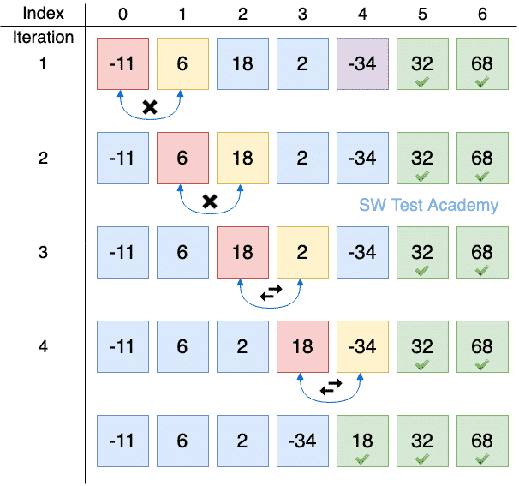
Bubble Sort
A simple sorting algorithm that works by comparing two adjacent elements and swaps them until they are in correct order.
Just like air bubbles in waters rises up to the surface, at the end of each pass in Bubble Sort highest element moves to the end (while sorting in ascending order) or lowest element moves to the end (while sorting in descending order).

Slide 3
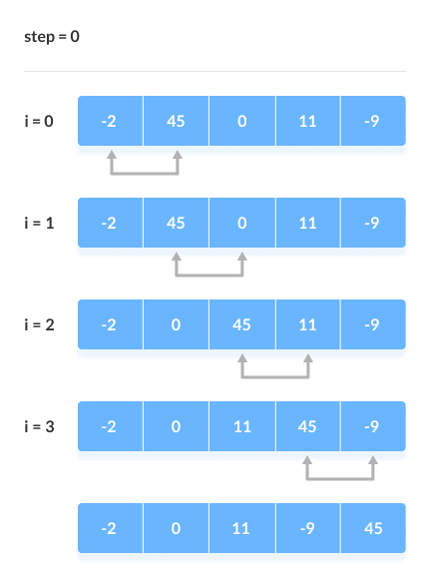
Bubble Sort (Simulation)

Slide 4
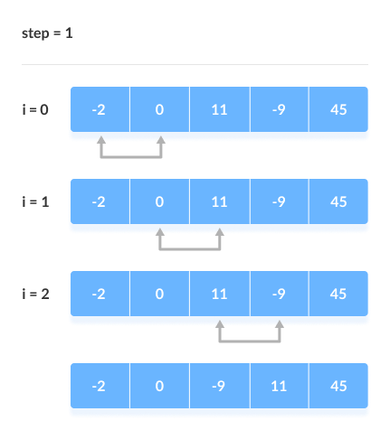
Bubble Sort (Simulation)

Slide 5
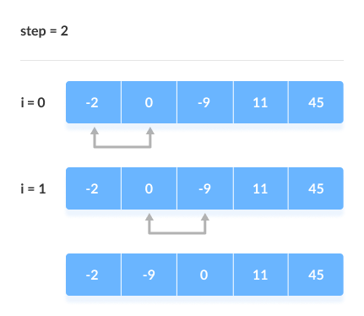
Bubble Sort (Simulation)

Slide 6
Bubble Sort (Pseudocode)
bubbleSort(array)
for i <- 0 to sizeOfArray - 1
for j <- 0 to sizeOfArray - 1 - i
if leftElement > rightElement
swap leftElement and rightElement
end bubbleSort

Slide 7
Optimized Bubble Sort (Pseudocode)
bubbleSort(array)
for i <- 0 to sizeOfArray - 1
swapped <- false
for j <- 0 to sizeOfArray - 1 - i
if leftElement > rightElement
swap leftElement and rightElement
swapped <- true
if swapped equals false
break
end bubbleSort

Slide 8
Bubble Sort (Properties)
Time Complexity:
Best Case: O(n) when array is sorted already.
Average Case: O(n²) when array is in random order.
Worst Case: O(n²) when array is in reverse order.
Space Complexity:
Best/Average/Worst case: O(1).
Stable: Yes.
Inplace: Yes.
Suitable for smaller arrays. Unsuitable for larger arrays and when lesser swapping is preferred.

Slide 9
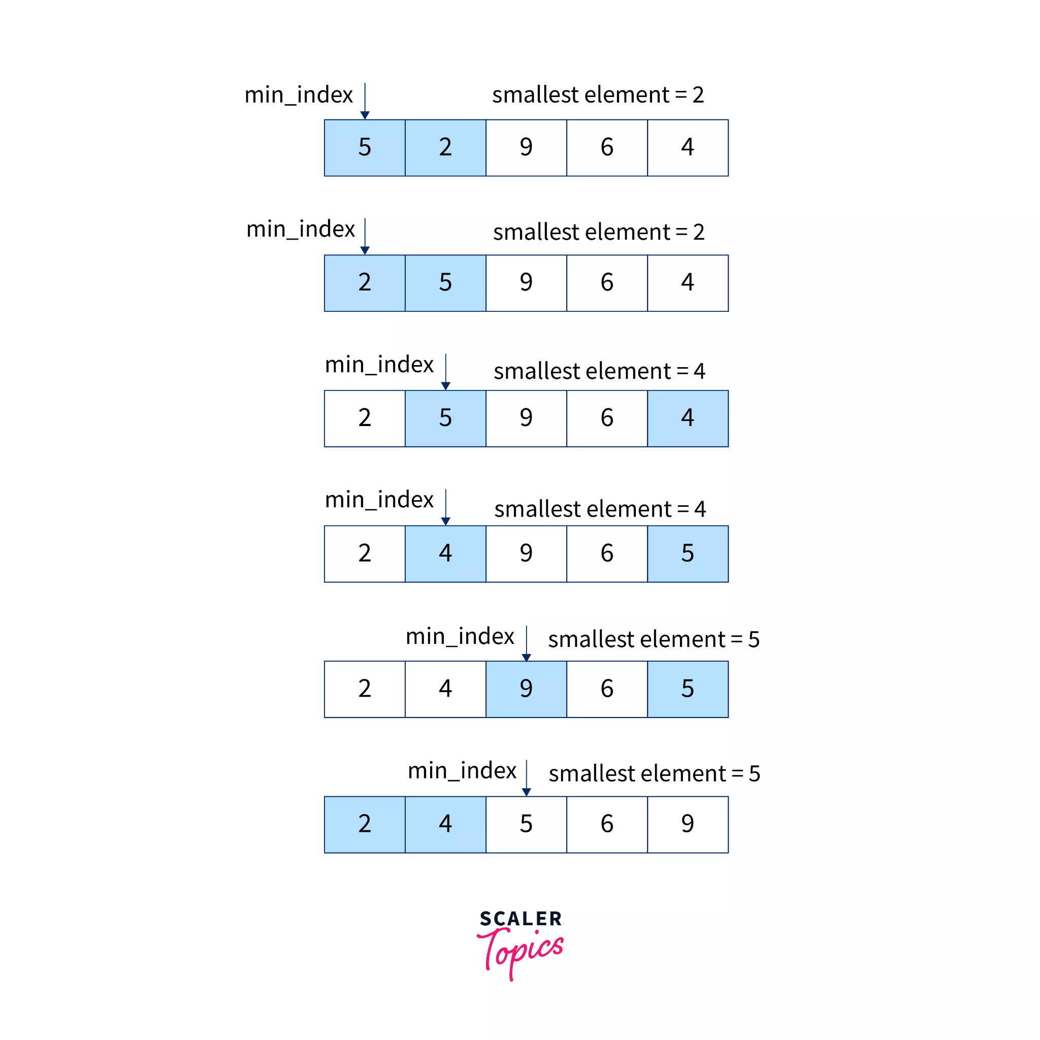
Selection Sort
A simple sorting algorithm that selects the lowest value in an array and moves it to the front of the array.
The basic logic is to select the smallest element from the unsorted part and swap it with the min_index element.

Slide 10
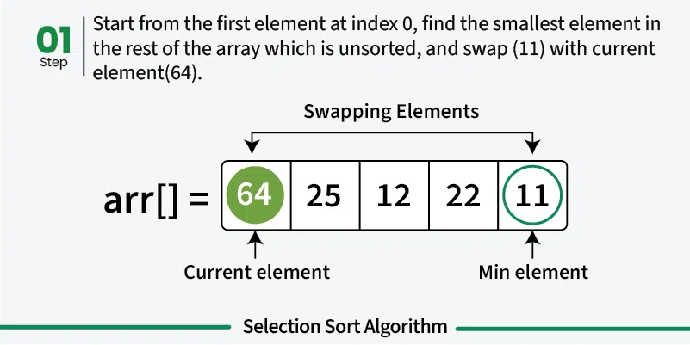
Selection Sort (Simulation)

Slide 11
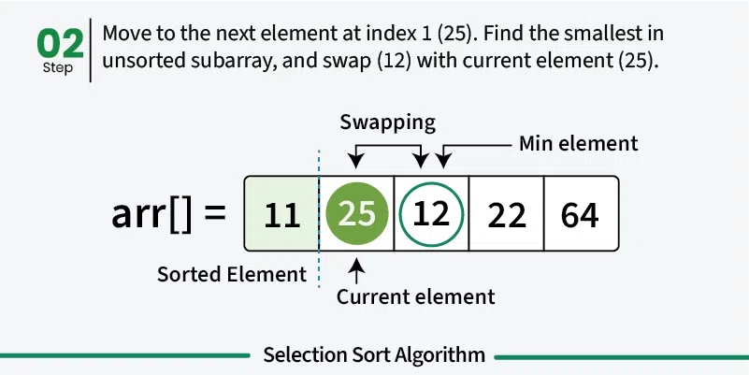
Selection Sort (Simulation)

Slide 12
Selection Sort (Simulation)

Slide 13
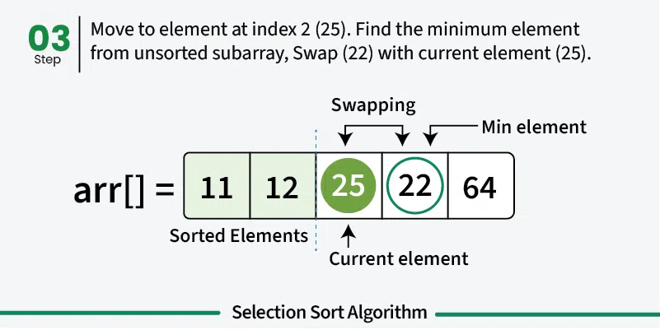
Selection Sort (Simulation)

Slide 14
Selection Sort (Simulation)

Slide 15
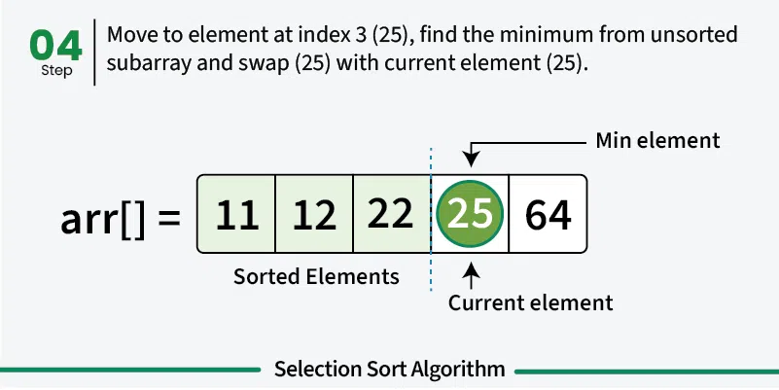
Selection Sort (Simulation)

Slide 16
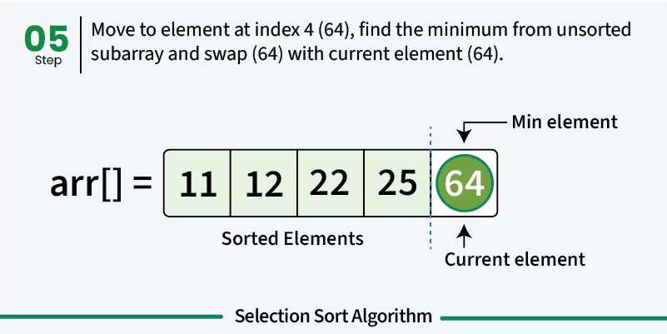
Selection Sort (Simulation)

Slide 17
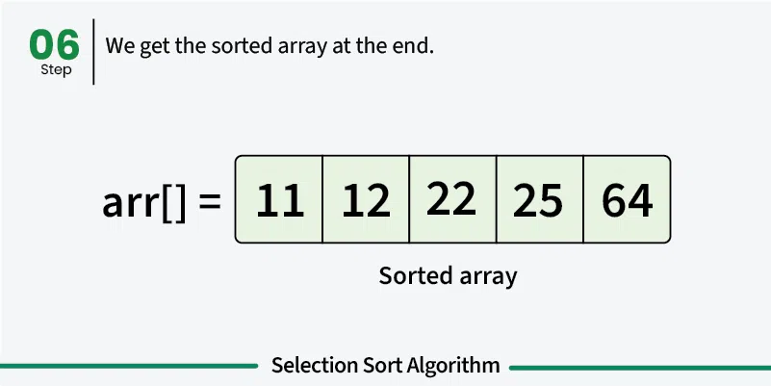
Selection Sort (Simulation)

Slide 18
Selection Sort (Pseudocode)
selectionSort(array, size)
for i from 0 to size - 1 do
set i as the index of the current minimum
for j from i + 1 to size do
if array[j] < array[current minimum]
set j as the new current minimum index
if current minimum is not i
swap array[i] with array[current minimum]
end selectionSort

Slide 19
Selection Sort (Properties)
Time Complexity:
Best Case: O(n²) when array is sorted already.
Average Case: O(n²) when array is in random order.
Worst Case: O(n²) when array is in reverse order.
Space Complexity:
Best/Average/Worst case: O(1).
Stable: No.
Inplace: Yes.
Suitable for smaller arrays and when lesser swapping is preferred. Unsuitable for larger arrays.

Slide 20
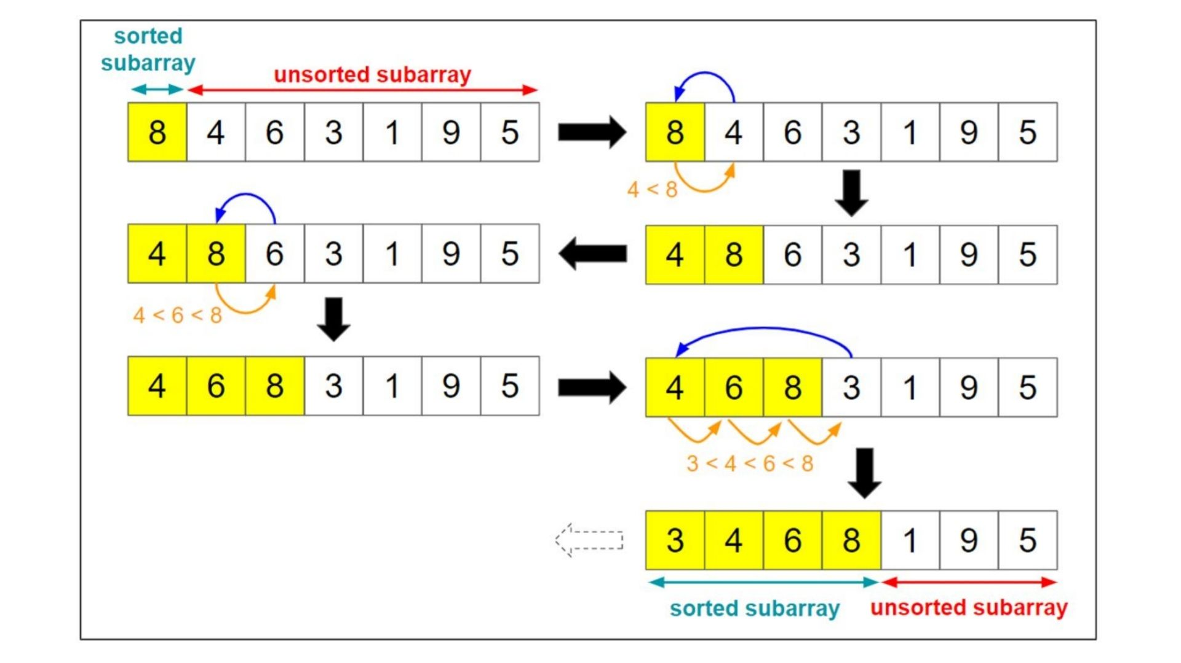
Insertion Sort
A simple sorting algorithm that works by iteratively inserting each element of an unsorted list into it’s correct position in sorted list by comparing.

Slide 21
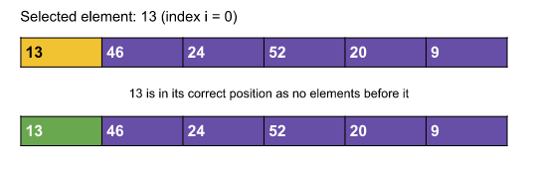
Insertion Sort (Simulation)

Slide 22
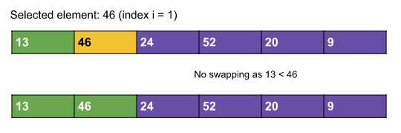
Insertion Sort (Simulation)

Slide 23
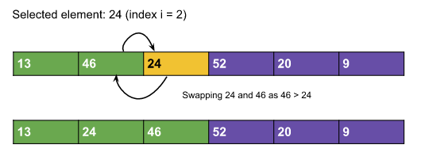
Insertion Sort (Simulation)

Slide 24
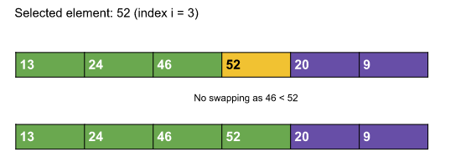
Insertion Sort (Simulation)

Slide 25
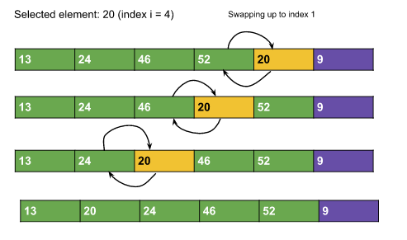
Insertion Sort (Simulation)

Slide 26
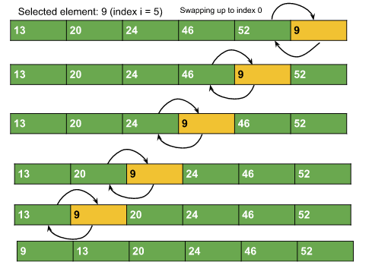
Insertion Sort (Simulation)

Slide 27
Insertion Sort (Pseudocode)
insertionSort(array)
mark first element as sorted
for each unsorted element X
'extract' the element X
for j <- lastSortedIndex down to 0
if current element j > X
move sorted element to the right by 1
break loop and insert X here
end insertionSort

Slide 28
Insertion Sort (Properties)
Time Complexity:
Best Case: O(n) when array is sorted already.
Average Case: O(n²) when array is in random order.
Worst Case: O(n²) when array is in reverse order.
Space Complexity:
Best/Average/Worst case: O(1).
Stable: Yes.
Inplace: Yes.
Suitable for smaller arrays and when a few elements needs to be sorted. Unsuitable for larger arrays.

